Slide 1
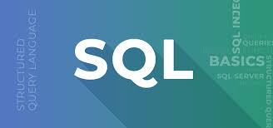

SQL: Data Manipulation and Definition Language
SQL is a powerful language for managing and manipulating data. It's widely used in databases across industries, from finance to healthcare.

Slide 2
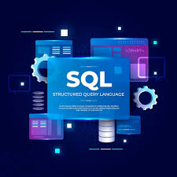
What is SQL?
Structured Query Language
SQL, short for Structured Query Language, is a standard computer language used for accessing and managing data in relational databases.
Interacting with Data
It enables users to retrieve, insert, update, and delete data from tables, as well as create, alter, and drop database objects.

Slide 3
Data Manipulation Language (DML)
Modifying Data
DML commands are used to change data within a database. It's all about working with existing data.
Common Operations
The most common DML commands include SELECT, INSERT, UPDATE, and DELETE, which correspond to retrieving, adding, modifying, and removing data.

Slide 4
SELECT, INSERT, UPDATE, DELETE
SELECT | Retrieve data from a table
INSERT | Add new rows to a table
UPDATE | Modify existing data in a table
DELETE | Remove rows from a table

Slide 5
Data Definition Language (DDL)
DDL stands for Data Definition Language, which is a subset of SQL that allows users to create, modify, and delete database objects. DDL statements are similar to computer programming languages and are used to define data structures, especially database schemas.

Slide 6
CREATE, ALTER, DROP, TRUNCATE
CREATE
Used to create new database objects, such as tables, views, or indexes.
ALTER
Used to modify the structure of existing database objects.
DROP
Used to delete entire database objects permanently.
TRUNCATE
Used to delete all data from a table, but the table structure remains intact.

Slide 7
DML vs. DDL: Key Differences
DML | DDL
Focuses on data manipulation. | Focuses on data definition.
SELECT | CREATE
INSERT | ALTER
UPDATE | DROP
DELETE | TRUNCATE

Slide 8
Benefits of Using SQL DML and DDL
Data Integrity
Ensure data consistency and accuracy.
Flexibility
Adapt your database schema to changing requirements.
Standardized Language
Commonly used and understood across various database platforms.

Slide 9
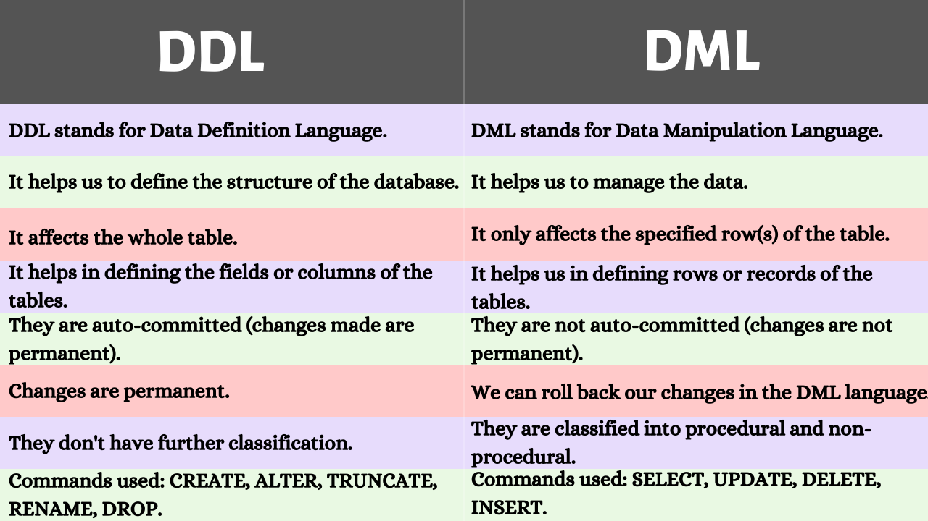

Slide 10
THANK YOU
BY BADUGU NAMRATHA JACINTHA
23071A7206

